Slide 1
Reference Slide (Remove before final)
Presentation (25 points)
The presentation itself is worth 25 points, or a full quarter of your grade for the final segment. This is your chance to share a polished, interview or boardroom ready deliverable.
Remember, you won't necessarily be graded on whether or not you've built the very best model. Instead, you'll be graded on your process: How did you select the model, and why? What roadblocks did you encounter (there are always roadblocks!), and how did you solve them?
Content
The presentation should tell a cohesive story about the project and include the following:
1 – Title Slide
2 - Selected topic
2 - Questions the team hopes to answer with the data
3-4 - Reason the topic was selected
5- Description of the source of data
6 - Description of the data exploration phase of the project
7 - Description of the analysis phase of the project
8 - Technologies, languages, tools, and algorithms used throughout the project
9 - Result of analysis
10 - Recommendation for future analysis
11 - Anything the team would have done differently
Slides
The presentation should be finalized in Google Slides and include the following:
Slides are primarily images or graphics (rather than primarily text).
Images are clear, in high-definition, and directly illustrative of subject matter.

Slide 2
Pneumonia Image
Analysis
To sneeze or not to Sneeze
Nothing to Sneeze at

Slide 3
Overview: Pneumonia Image Analysis
Goals:
Build a machine learning model to find distinct differences in chest x-ray images and accurately classify them as pneumonia or normal
Build a site where images can be uploaded and processed by our model and the results displayed for users to review
Provide a resource for doctors to speed up the interpretation of x-ray images
Provide additional background information and context around the impact of Pneumonia
Notes:
Project Use Case
The use case for generating this model is to develop a process to objectively analyze and interpret x-ray images with a rate of accuracy that is potentially better than the human eye.
This model could be a valuable resource for doctors and students as another tool for interpreting x-ray images and validating/invalidating their personal diagnoses.
Our goal is to generate a model that can predict the nuances between pneumonia, normal, or other to account that there are many potential diagnoses besides pneumonia to consider.

Slide 4
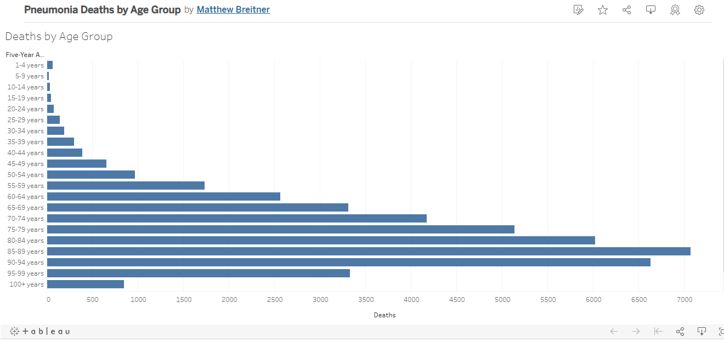
Why Pneumonia – Global Statistics
Globally, Pneumonia accounts for more than 15% of all deaths of Children under 5
Kills more children younger than 5 years old each year than any other infectious disease
Replace this chart with global chart once created
Notes:
Global Cases:
https://ourworldindata.org/pneumonia
US cases:
2018 Data
https://www.cdc.gov/nchs/data/nhamcs/web_tables/2018-ed-web-tables-508.pdf
1,485,000 ER visits for Pneumonia (out of 129,959,000 total)
40,000 Deaths (Most preventable)

Slide 5
Imaging Demands Outpace Radiologist Supply
2016 Mayo Clinic study* published in Academic Radiology outlines the increase in workload for radiologists
“Imaging volumes have grown at a disproportionate rate to imaging utilization increases at our institution. The average radiologist …must now interpret one image every 3–4 seconds in an 8-hour workday to meet workload demands.”
*https://www.academicradiology.org/article/S1076-6332(15)00245-7/fulltext
Notes:
Chest X-Ray is the one of the primary Diagnostic Tools for Pneumonia Identification and treatment
However, Radiologists are tasked with analyzing X-Ray, MRIs, and CT scans for all types of diseases and other medical diagnoses
According to a 2016 study, over 539,210,581 images analyzed at the Mayo Clinic alone between 1999 and 2010
The number of scans radiologists have to analyze has gone from 1 every 20 seconds to 1 every 4 seconds
Conclusions
Imaging volumes have grown at a disproportionate rate to imaging utilization increases at our institution. The average radiologist interpreting CT or MRI examinations must now interpret one image every 3–4 seconds in an 8-hour workday to meet workload demands.
https://appliedradiology.com/articles/the-radiologist-s-gerbil-wheel-interpreting-images-every-3-4-seconds-eight-hours-a-day-at-mayo-clinic

Slide 6
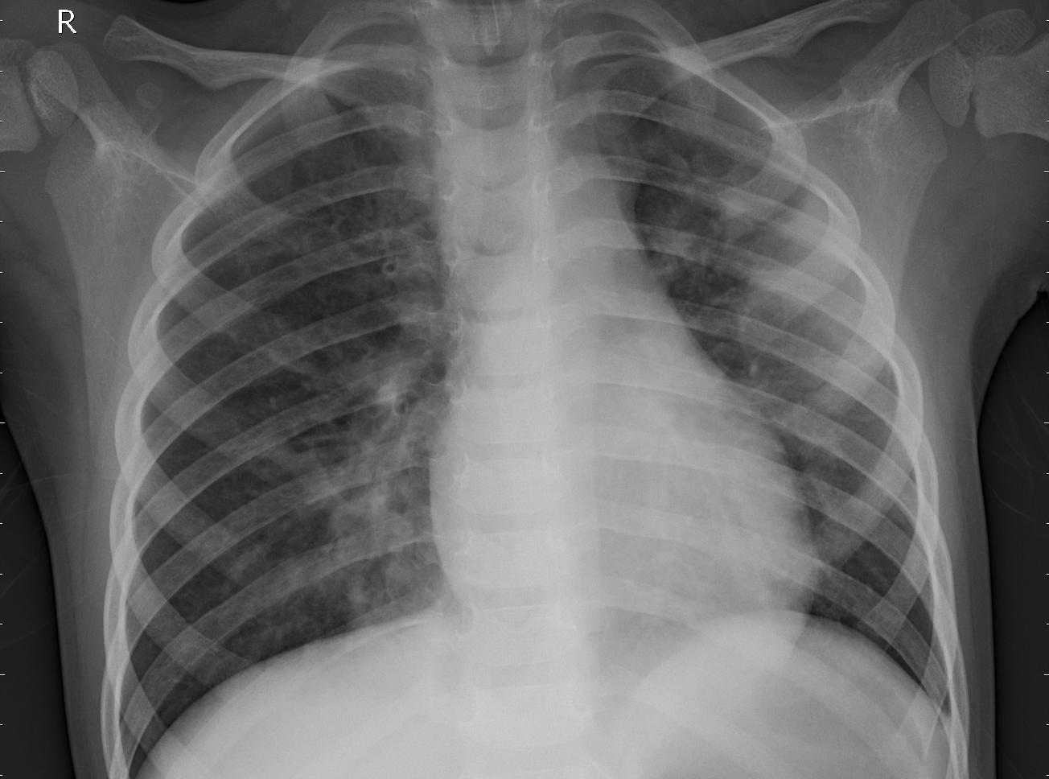
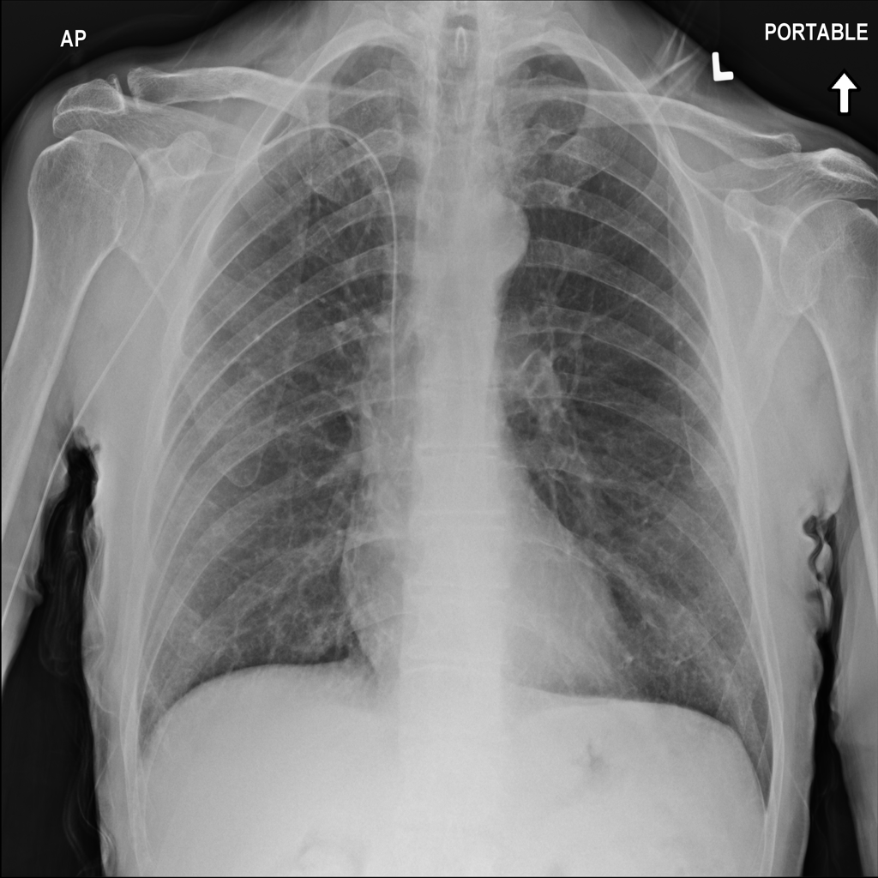
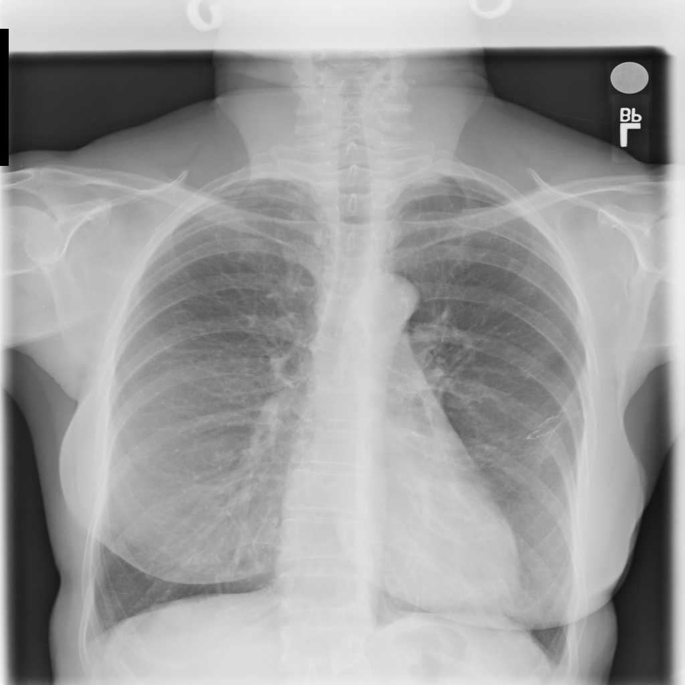
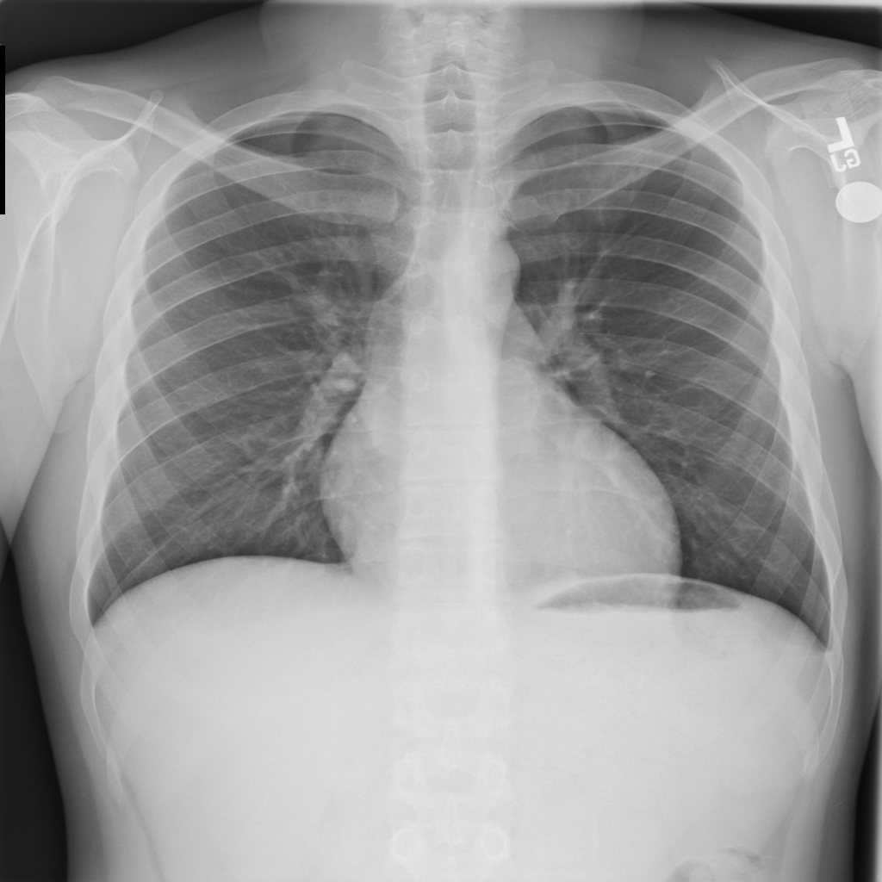
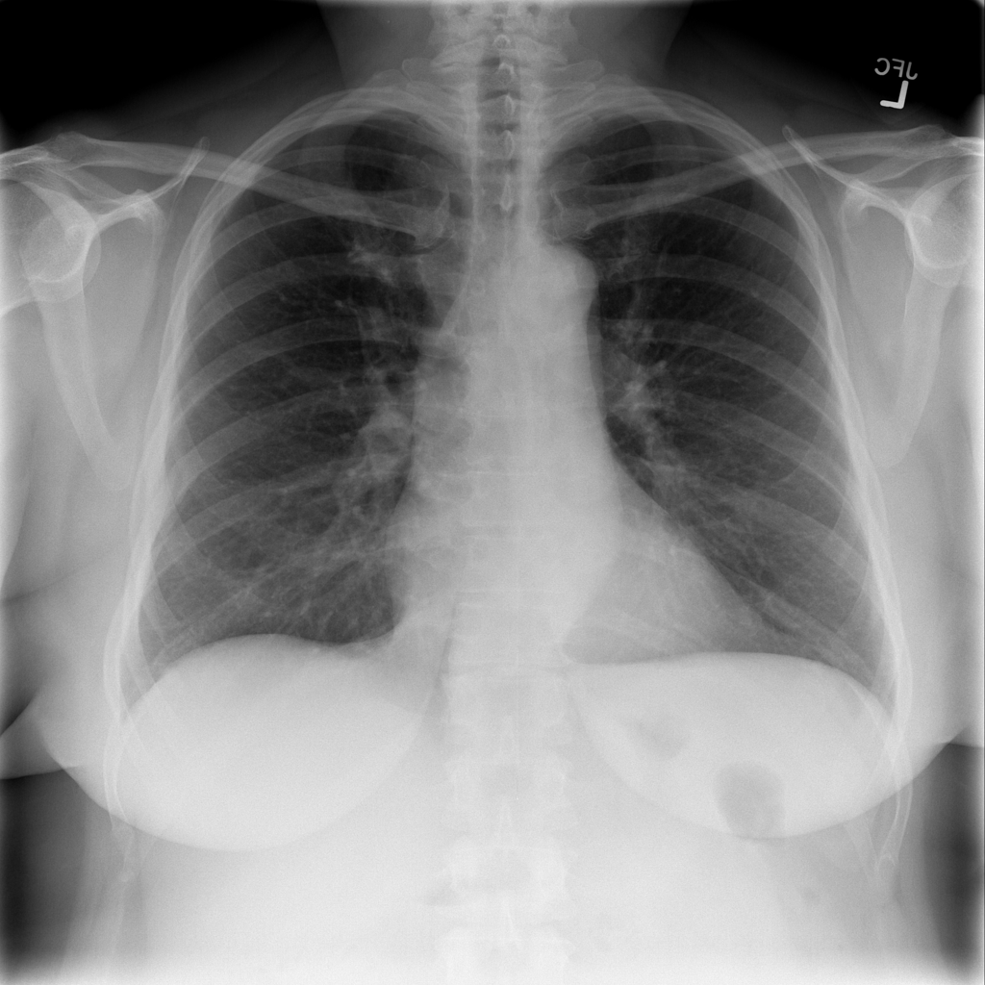
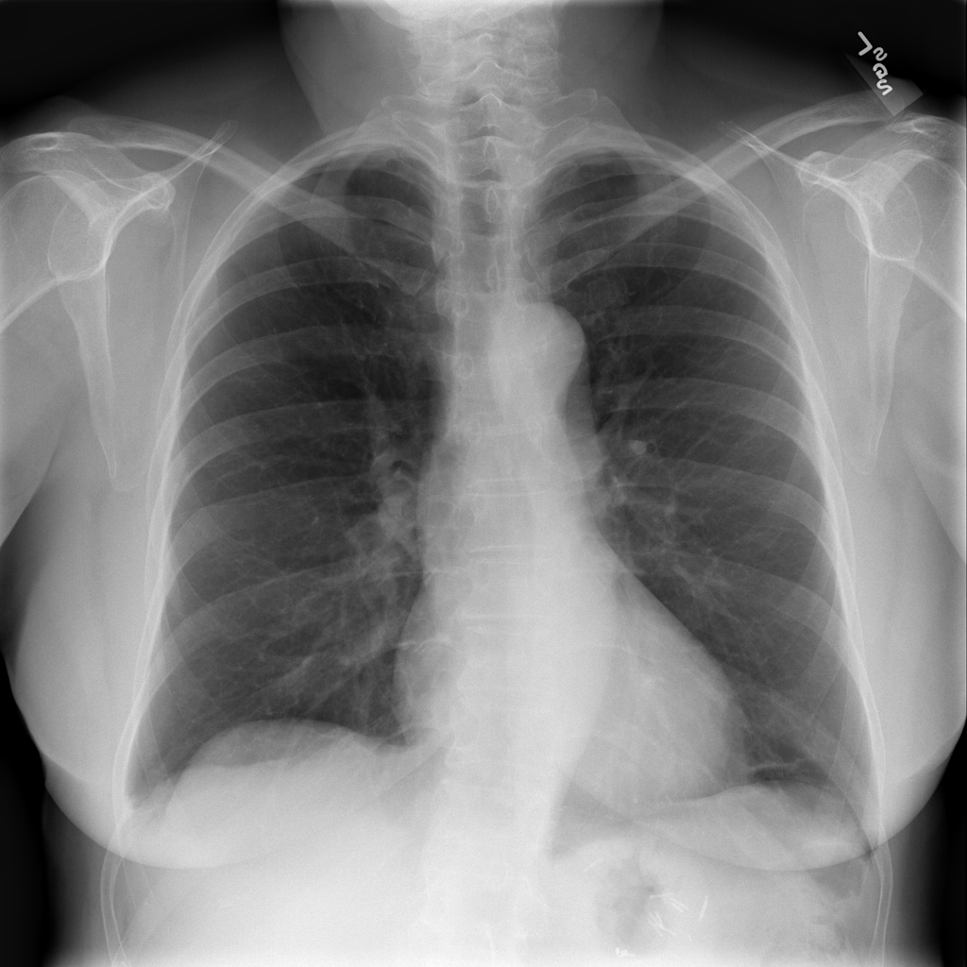
Can you spot the Pneumonia?
Notes:
Click on title during presentation to start the game
6 images will appear one at a time
3 seconds per image
Survey to determine everyone’s guess
Answer: Image 1

Slide 7
Data Sources
Two sets
One focused on Statistics
The other on Machine Learning Model images

Slide 8





Data Sources – Pneumonia Statistics
Notes:
General Pneumonia Statistics:
To help underscore the importance of Pneumonia detection, we compiled global data from WHO, UNICEF and ourworldindata.org as well as US data from the CDC
https://www.who.int/health-topics/pneumonia#tab=tab_1
https://ourworldindata.org/pneumonia
https://www.cdc.gov/dotw/pneumonia/index.html
https://wonder.cdc.gov/controller/datarequest/D76;jsessionid=303DD855FA935405980D61135452

Slide 9
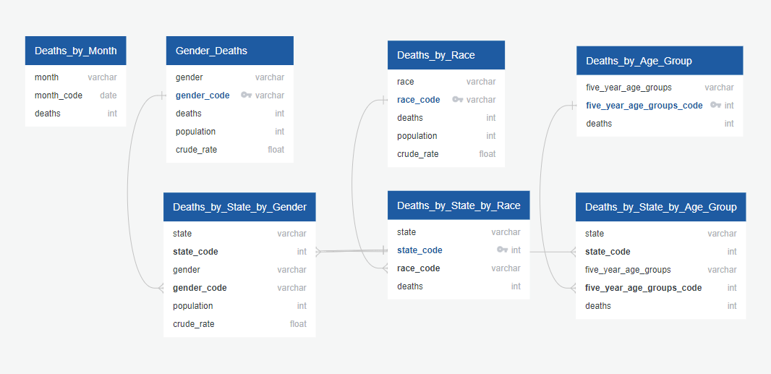
Data Exploration Phase – Statistics ETL Process and Database Tables

Slide 10



Data Sources – Machine Learning Model
Both Datasets were compiled on Kaggle
Images were reviewed at respective sources by qualified Radiologists
Guangzhou Women’s and Children’s Medical Center
5,863 images
Divided into Pneumonia and Normal
Pediatric patients of one to five years old
National Institutes of Health Database
112,120 images
14 different diseases
Collected through NLP mining of radiology reports with >90% accuracy
Notes:
Model Data:
Found a large number of sites utilizing Chest Xray images for Pneumonia, Covid and other diseases, particularly on Kaggle
When reviewing source data for each site, discovered that most sites were pulling their images from 4 different Datasets
After analyzing the 4 source datasets, narrowed the scope to two sets where we could verify the origins of the images and confirm that the images had been reviewed by Radiologists
Based on the datasets, we asked ourselves whether we could expand the scope of the project to include an “other” category for images that were Not Pneumonia but also Not Normal

Slide 11
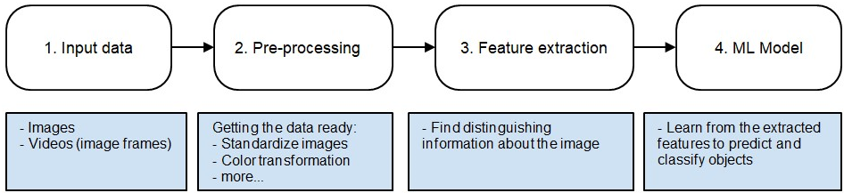
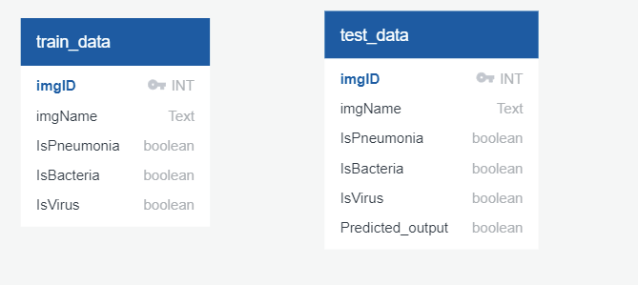
Data exploration Phase – Model Data
4 - Description of the data exploration phase of the project
NEED TO UPDATE Table structure images

Slide 12
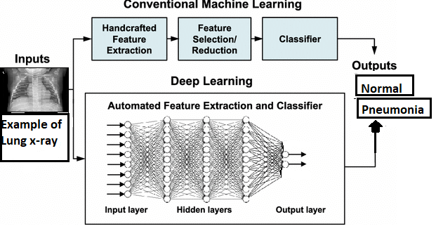
Model explanation and analysis
5 - Description of the analysis phase of the project
Replace/Update this Image
Notes:
One of the biggest concerns was image bias and accuracy
Recognized early on that there were some limitations to our basic model – it doesn’t take into account images that may be uploaded that have other Diseases or issues
Worked on building several different Model variations to determine what level of accuracy we could get with different dataset builds
Basic model is strictly Pneumonia vs Normal
Pneumonia vs Non-Pneumonia which tried to combine Normal images with Diseases other than Pneumonia
2 model which first compared images as “Normal vs Other” and if the result was “other” it was pushed through a second model for “Pneumonia vs Other Diseases”
While our more advanced models showed promise, we ultimately opted to keep the initial model of Pneumonia vs Normal due to time limitations

Slide 13
Technology
6 - Technologies, languages, tools, and algorithms used throughout the project
Where in the presentation should we put this?
Database
AWS for data storage
PGAdmin and PostgreSQL for data table generation and manipulation
Machine Learning
Google Collab for machine learning model generation
cv2 package for image analysis and preparation
TensorFlow package for machine learning model generation
Visualization Technologies
hvplot/plotly for visualizing the outputs of our classification model and results of our model
Tableau Public for additional visualization support
Heroku for hosting visualizations
Other
Flask for website Development
VS Code and Spyder for coding

Slide 14
Results
Model accuracy: (insert Model charts here)
Website Demo: https://pneumonia-detection-analysis.herokuapp.com/

Slide 15
Beyond the Model
8 - Recommendation for future analysis
Could this model be further applied to chest x-rays with diagnoses outside of pneumonia and be adapted to interpret the x-rays of patients with an array of diagnoses?
If we set up our database is to take in new images can we use them to periodically update the model to improve the lifelong accuracy of the model?
Building the ability to upload and analyze multi images at a time

Slide 16
9 - Anything the team would have done differently

